Slide 1

Bosch Mechanical Design Summer School Project
by Alexandru Mihai Bota

Slide 2
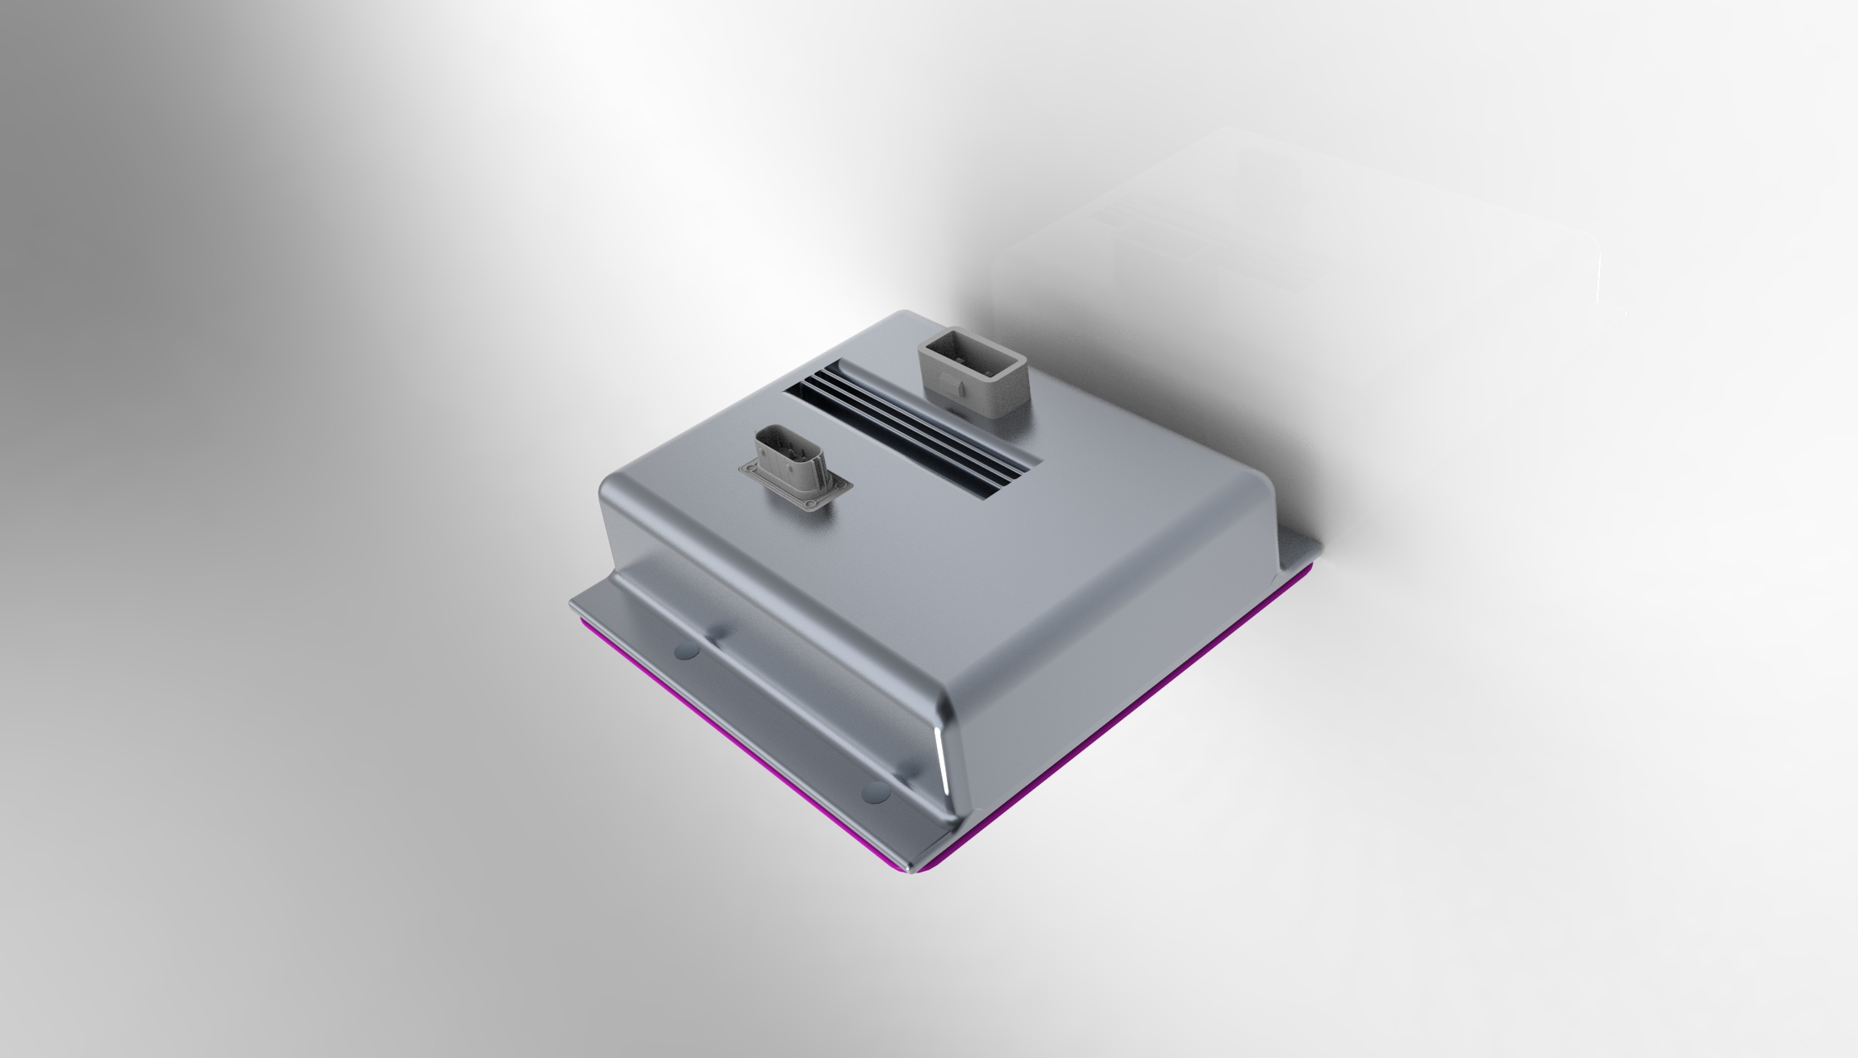
Arduino case
A very reliable casing rated at IP66 which prohibits any ingress of dust and protects against potential water damage caused by powerful jets directed against the enclosure from any direction.

Slide 3
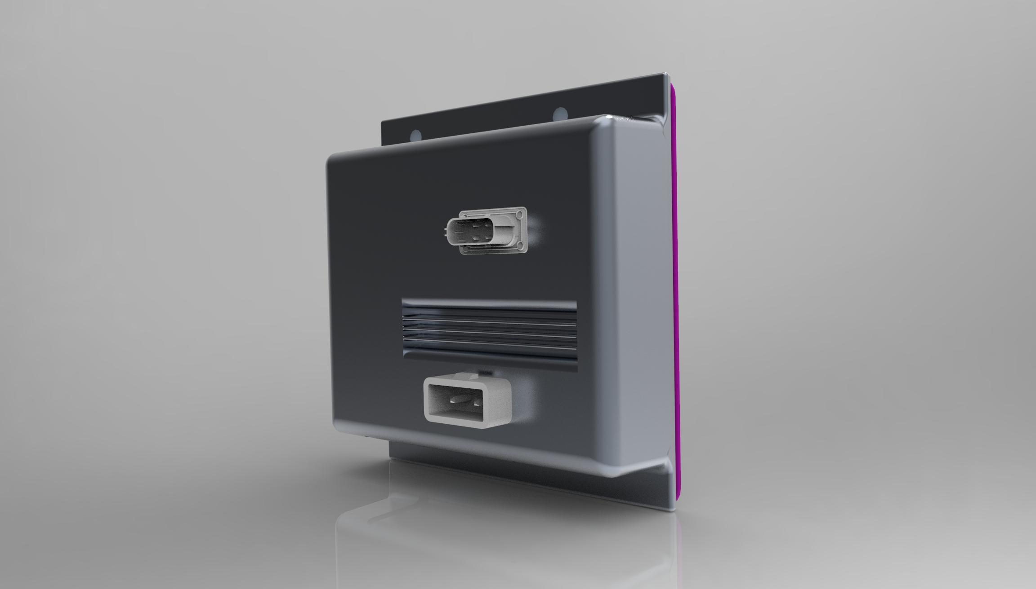
As temperature resistance its aluminium and PBT components ensure optimal results at temperatures ranging from -25 to 120 ˚C

Slide 4
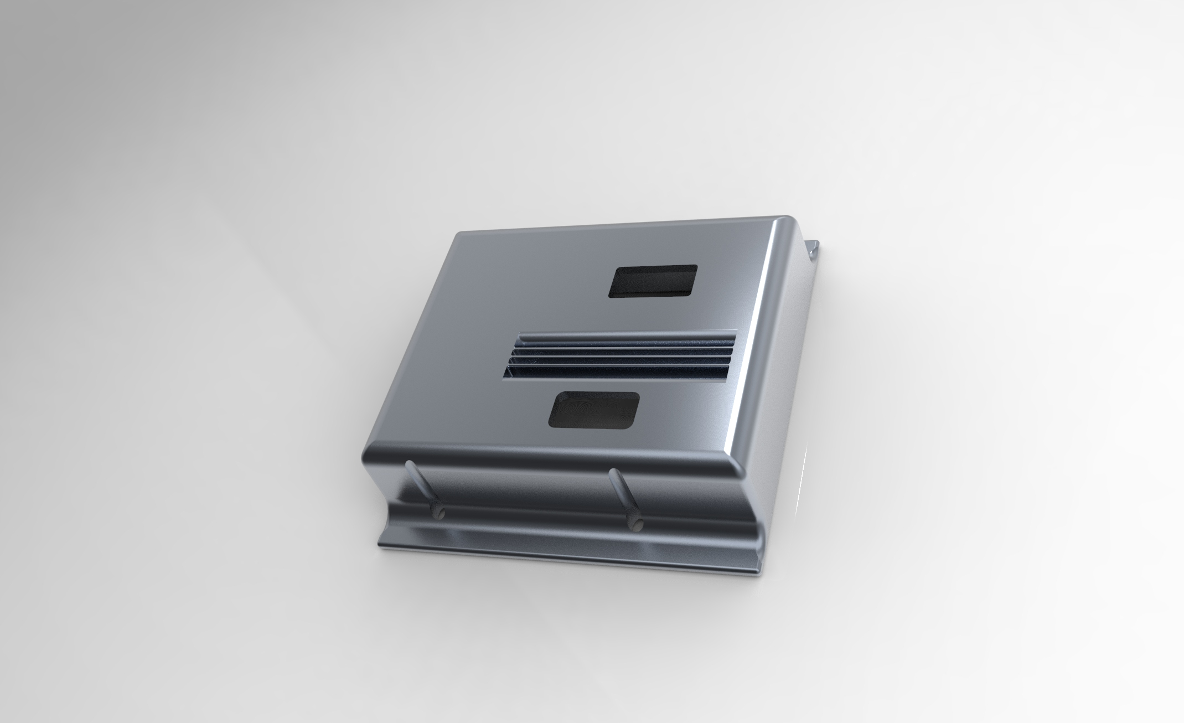
Upper casing

Slide 5
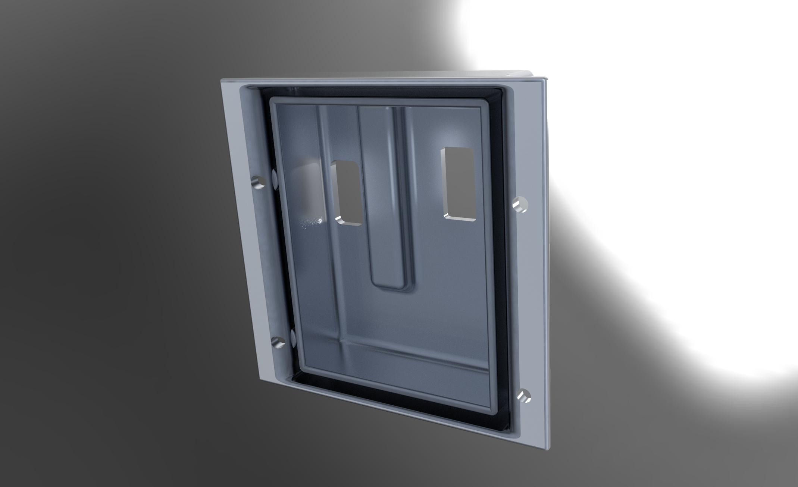

Slide 6
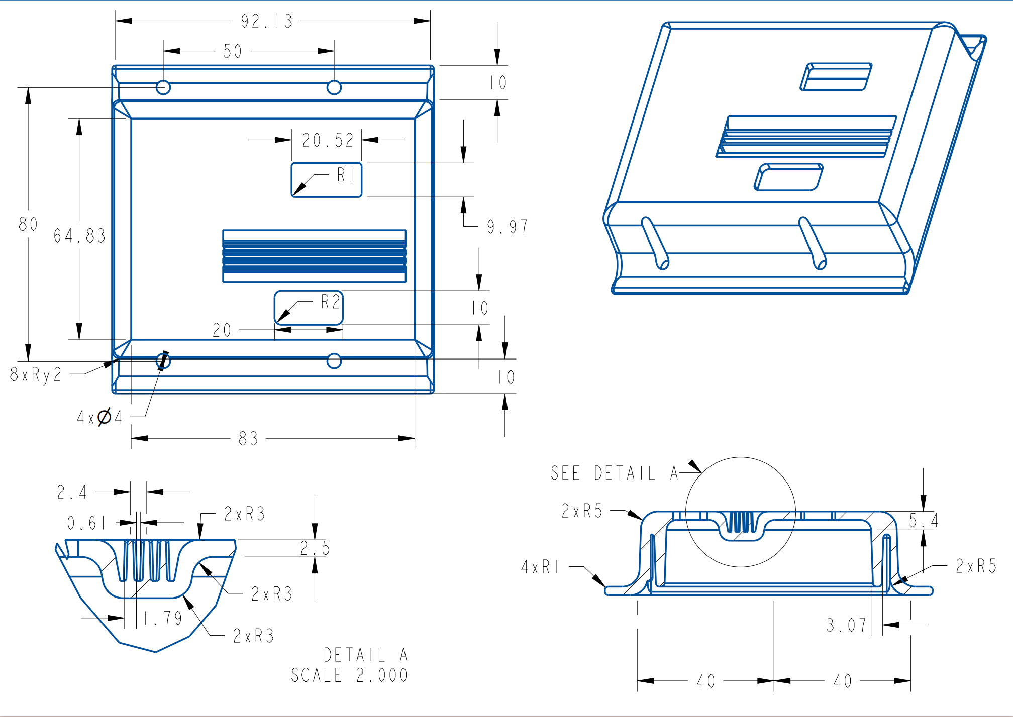
This part also contains the heat sink component represented by the ribs located on top of the microcontroller which help in diminishing the thermal energy resulted from the PCB. This process is aided by the use of TIM.

Slide 7
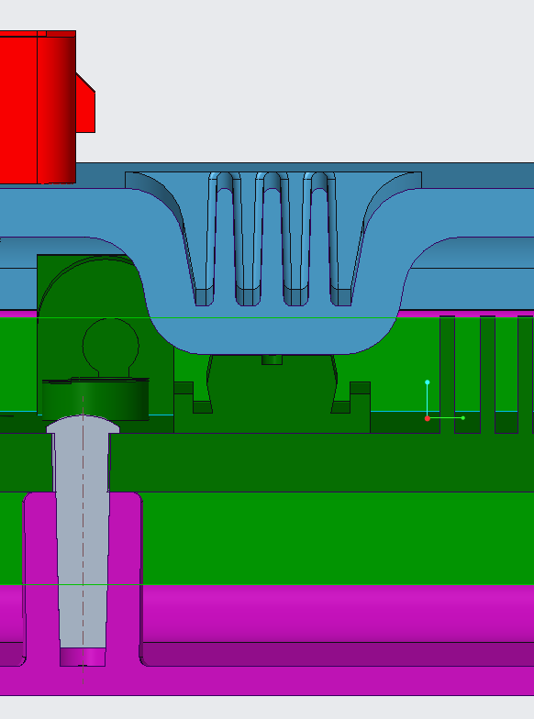

Slide 8
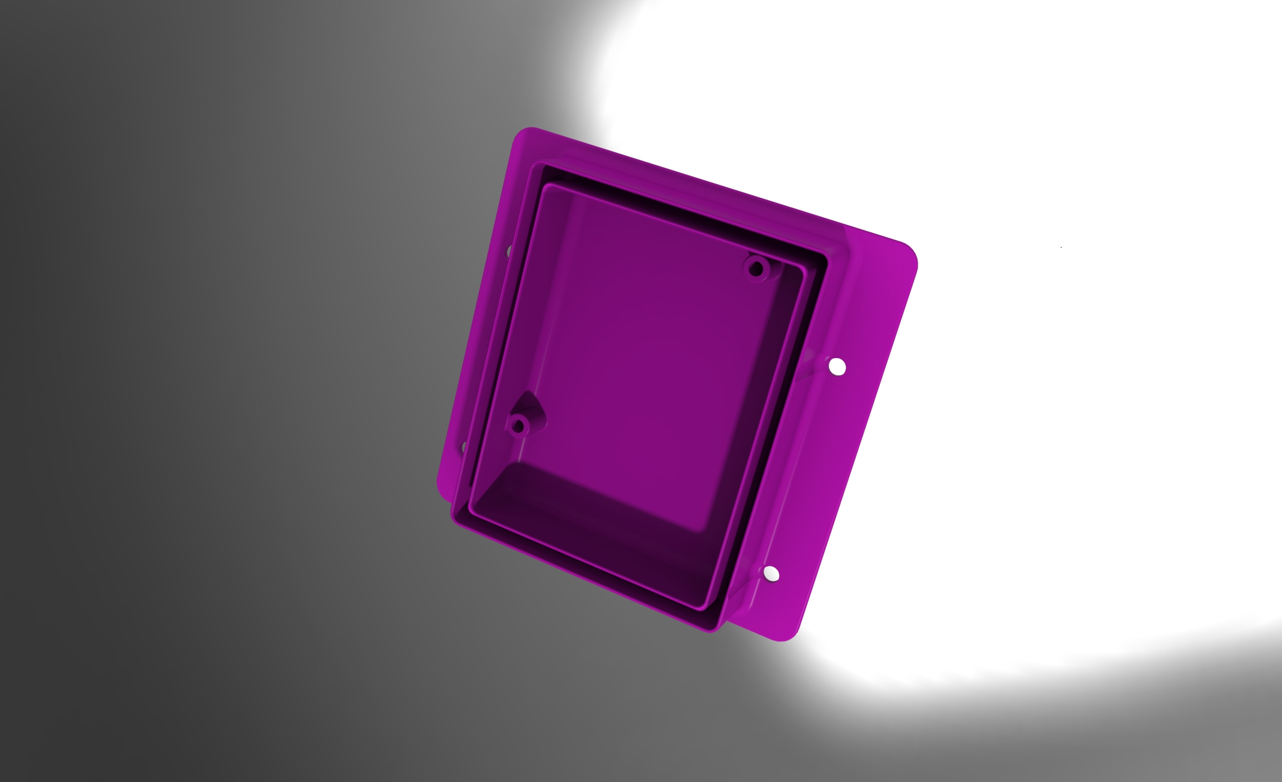
Lower casing

Slide 9
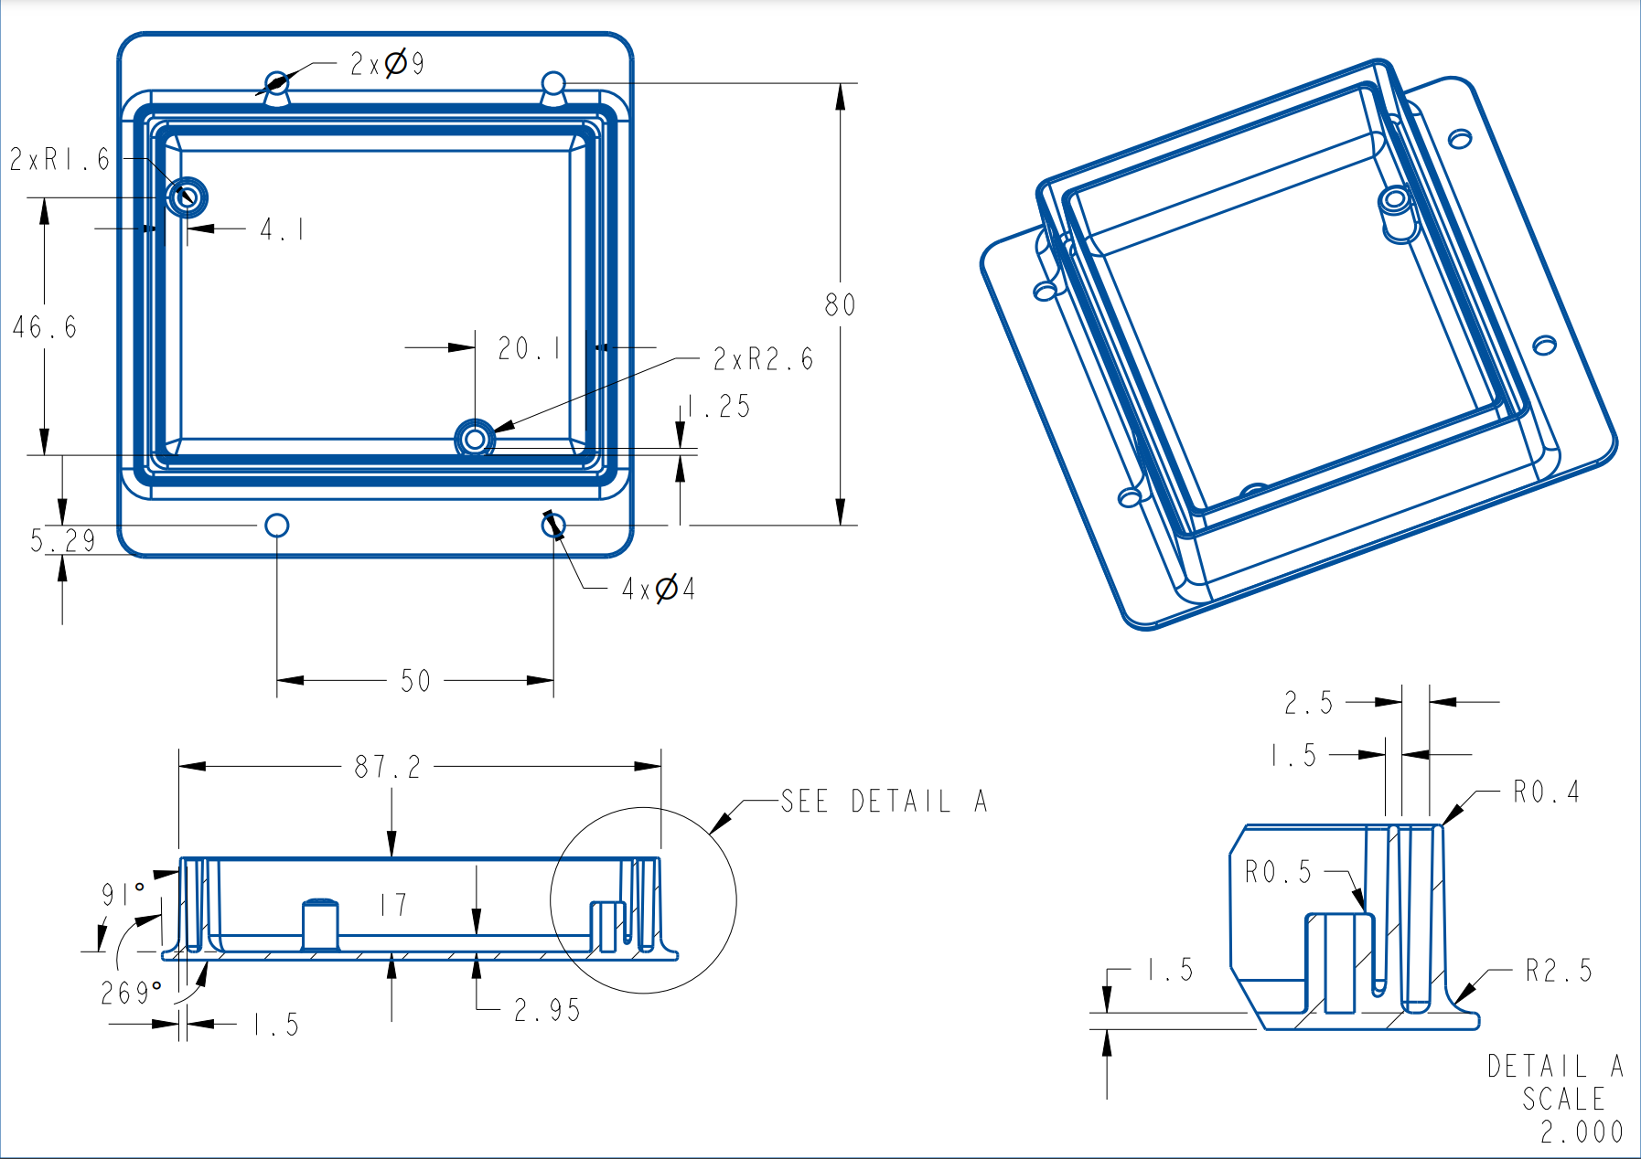
Being made out of PBT plastic brings numerous advantages:
High strength and rigidity
Dimensionally stable
Low tendency to creep
Very good frictional and wear resistance
Good impact strength
Very low coefficient of thermal expansion
Good chemical resistance to acids
Excellent resistance to chlorine and caustics
Very good electrical characteristics
Very low moisture absorption

Slide 10
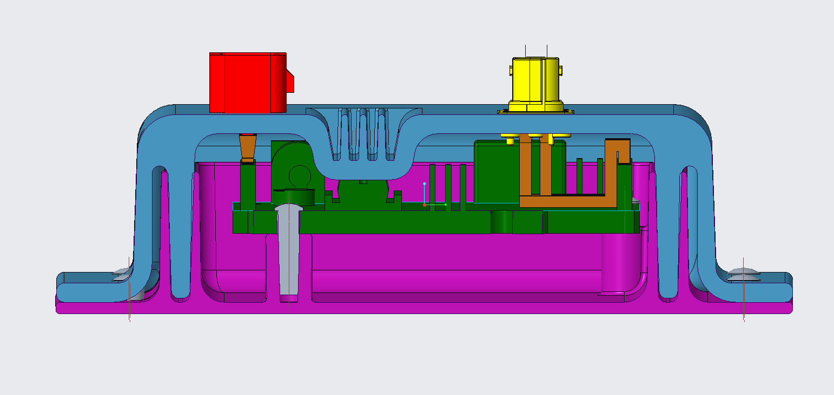
Sealing

Slide 11
